Slide 1
How to link a portfolio to a different bibliographic record
Yoel Kortick
Senior Librarian

Slide 2

Introduction
Our sample portfolio
Relinking the portfolio to another bibliographic record
Agenda

Slide 3
Introduction

Slide 4
Introduction
In addition to this presentation see also Linking a Portfolio to a Different Record
There are cases where an institution has activated an electronic collection from the Community Zone and the Electronic Collection has a portfolio for which there is a "more preferred" bibliographic record in the institution.

Slide 5
Introduction
In a situation such as this the institution can link that portfolio from the community zone to a different bibliographic record.
That different bibliographic record may be one already catalogued in the institution.

Slide 6
Our sample portfolio

Slide 7
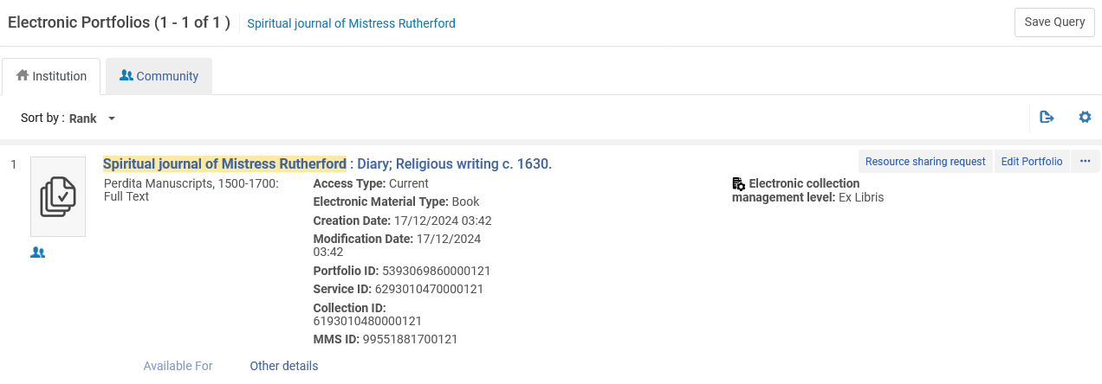
Our sample portfolio
Portfolio Title "Spiritual journal of Mistress Rutherford" is part of Electronic Collection "Perdita Manuscripts: Women Writers, 1500-1700".
The portfolio is linked to the Community Zone

Slide 8
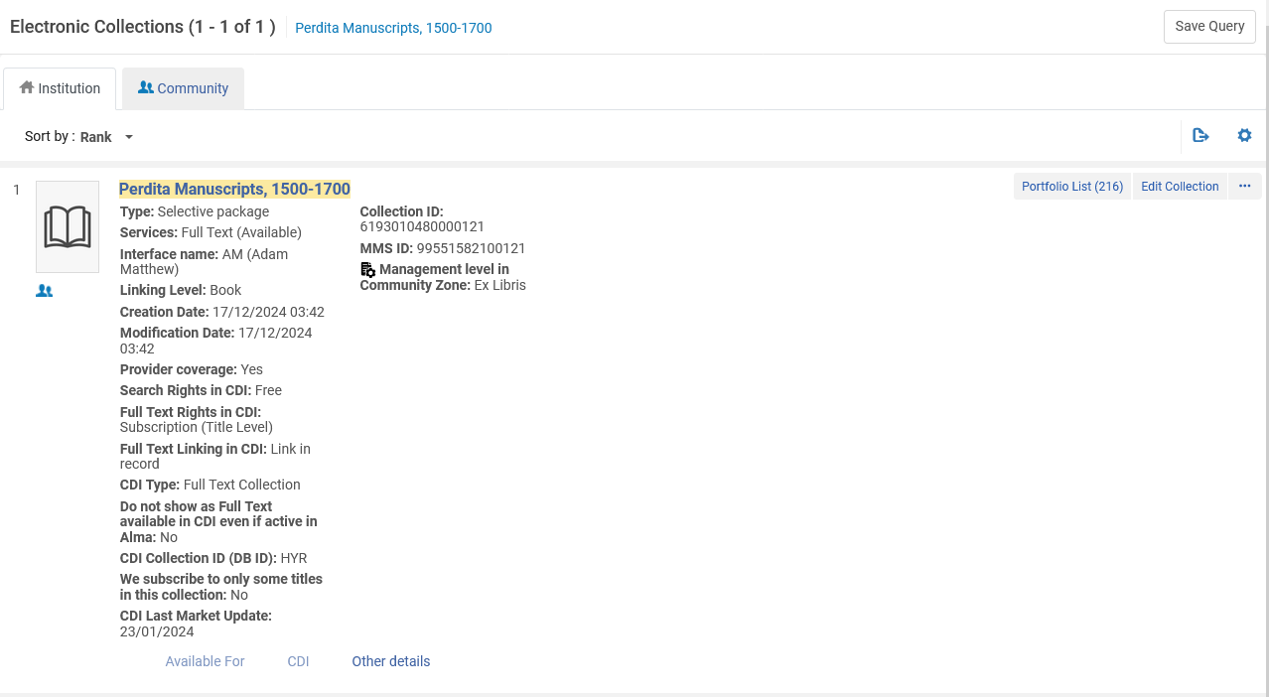
Our sample portfolio
Electronic Collection "Perdita Manuscripts: Women Writers, 1500-1700" has been activated in the institution from the Community Zone.

Slide 9
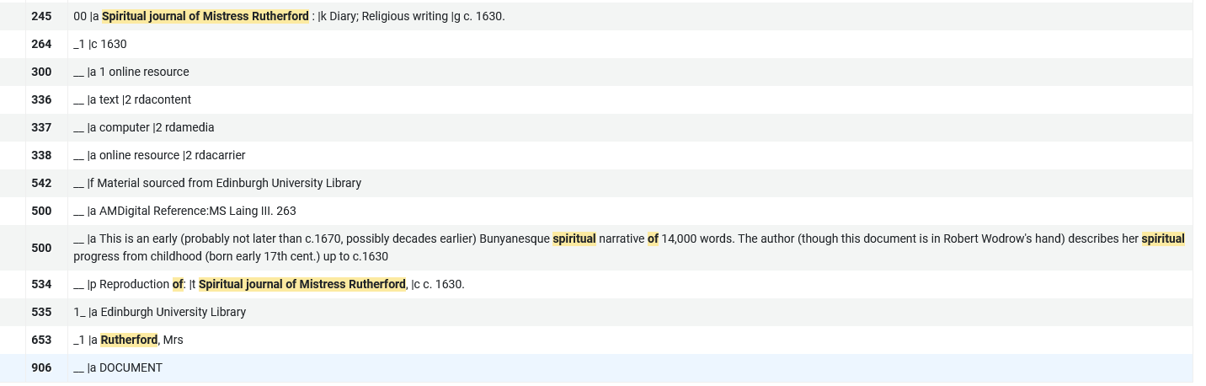
Our sample portfolio
The title "Spiritual journal of Mistress Rutherford" does not have any 650 fields and does have a 906 field
No 650 and does have a 906

Slide 10
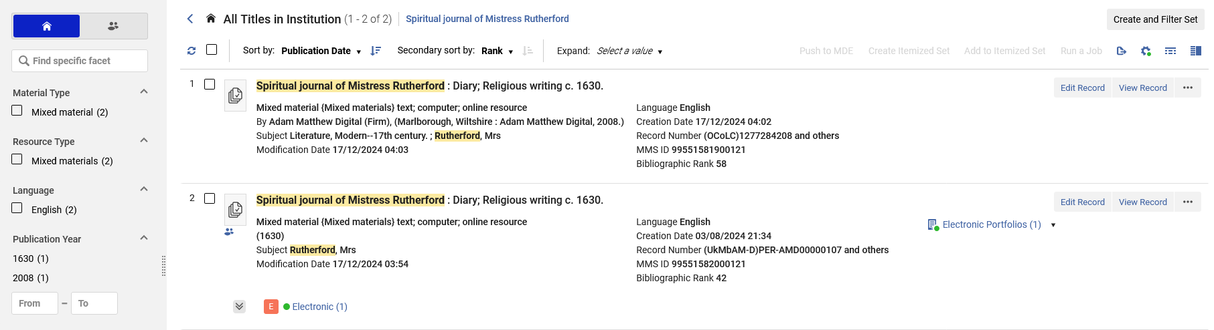
Our sample portfolio
But ... The institution just happens to have a fuller bibliographic record of "Spiritual journal of Mistress Rutherford" (with 650 fields)
The current bibliographic record of the portfolio is linked to the Community Zone. The record already in the institution is not linked to the Community Zone

Slide 11
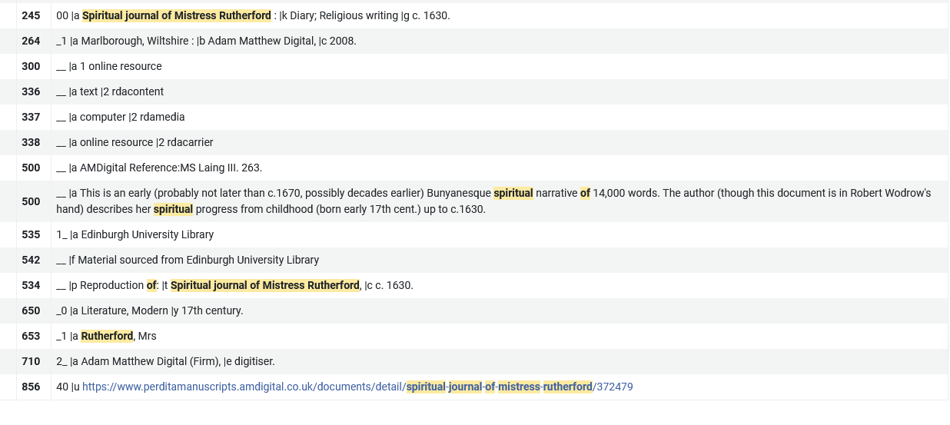
Our sample portfolio
This (MMSID 99551581900121) is the institution’s record of title "Spiritual journal of Mistress Rutherford" with a 650 field and without a 906.
Has a 650 and does not have a 906

Slide 12
Relinking the portfolio to another bibliographic record

Slide 13
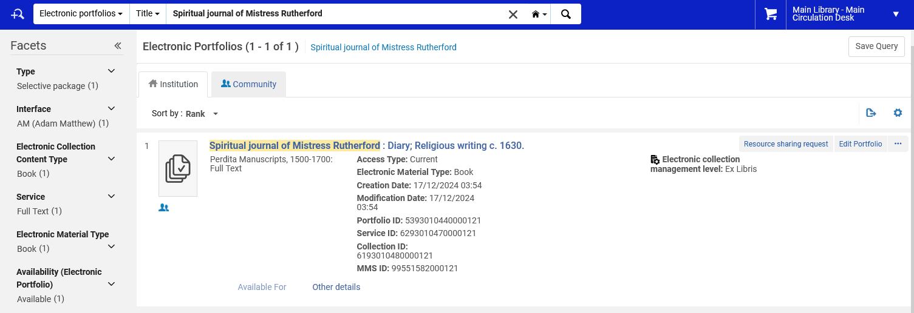
Relinking the portfolio to another bibliographic record
Search the institution for the portfolio which you want to link to a different bibliographic record and open in the portfolio editor

Slide 14
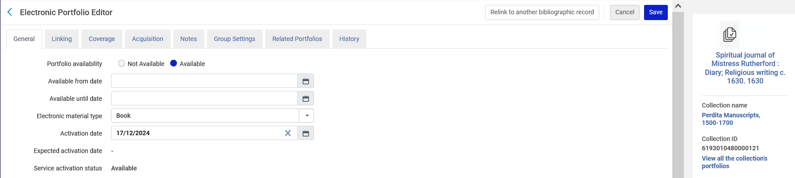
Relinking the portfolio to another bibliographic record
Click "Relink to another bibliographic record"

Slide 15
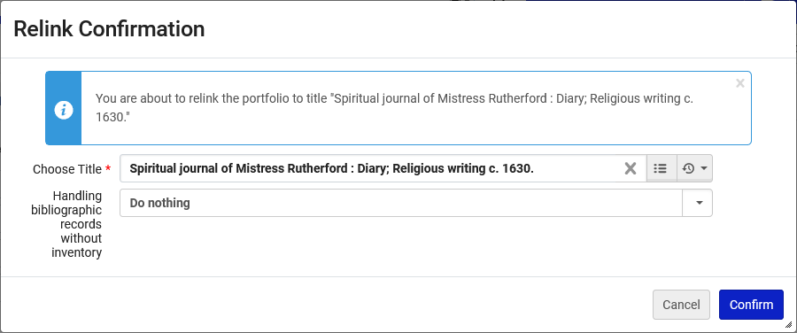
Relinking the portfolio to another bibliographic record
In the "Relink Confirmation" window use the "Choose Title" field to search for and select the desired title to which you want to relink.
We have searched for and selected the desired title

Slide 16
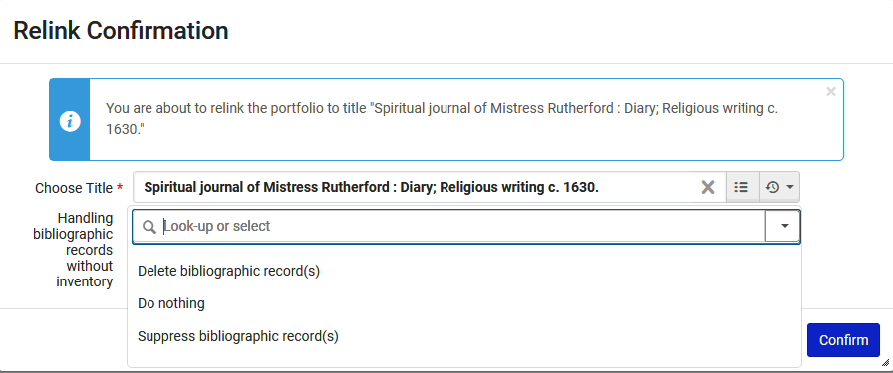
Relinking the portfolio to another bibliographic record
Choose how you want to handle the unlinked bibliographic record

Slide 17
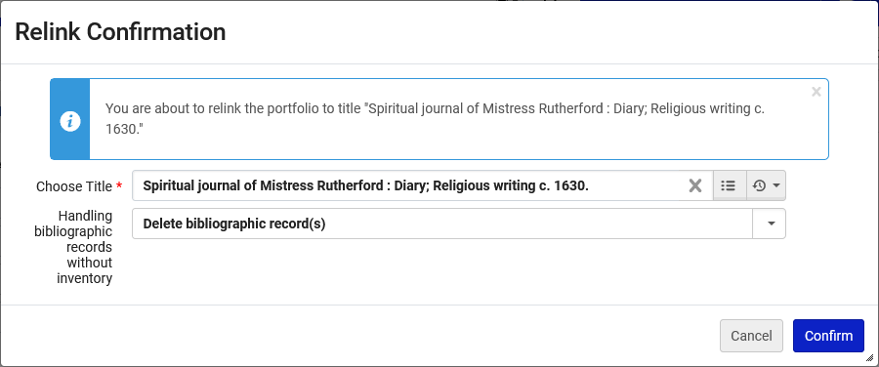
Relinking the portfolio to another bibliographic record
We have chosen to delete the unlinked bibliographic record, and we will click "Confirm"

Slide 18
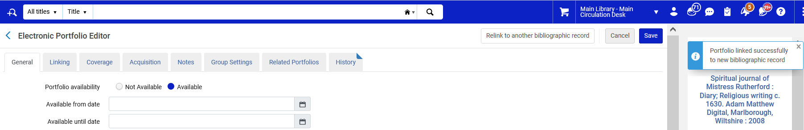
Relinking the portfolio to another bibliographic record
The portfolio has been relinked to the bibliographic record which does have a 650 field and does not have a 906 field.

Slide 19
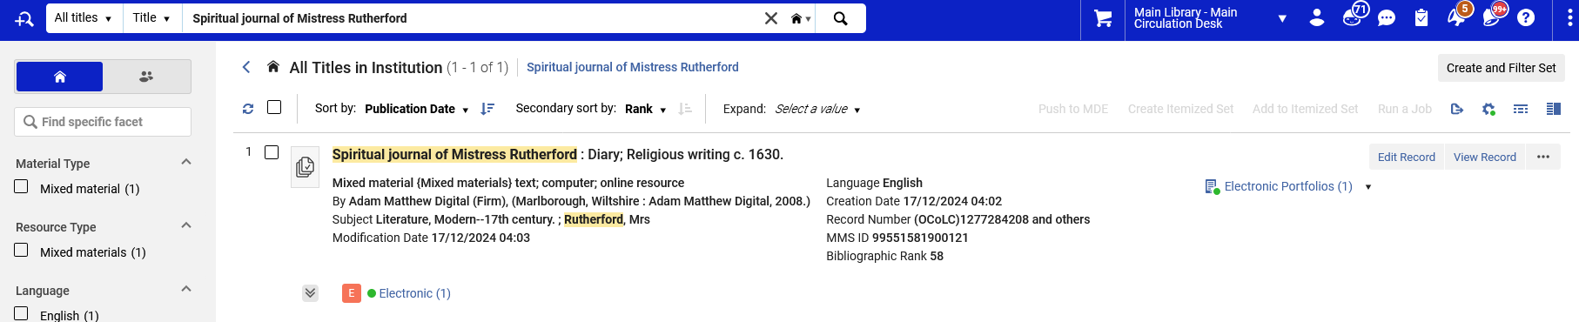
Relinking the portfolio to another bibliographic record
Now there is one bibliographic record for title "Spiritual journal of Mistress Rutherford" and it is the preferred record which was already in the institution (with the 650 field and without the 906 field).
This is from the 650 field
The bibliographic record is not linked to the Community Zone (no icon)

Slide 20
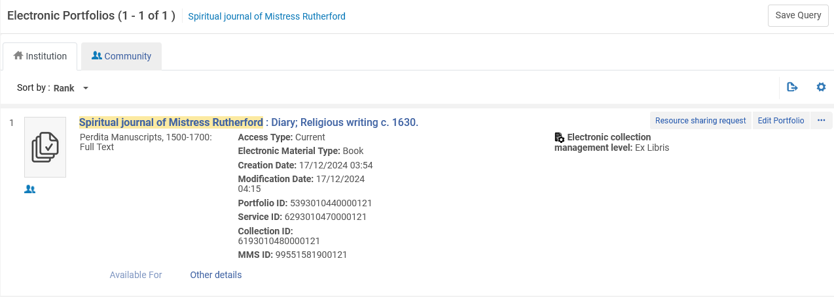
Relinking the portfolio to another bibliographic record
Here is the portfolio. It is still linked to the Community one (even though the bibliographic record is not)
The portfolio is linked to the Community Zone

Slide 21
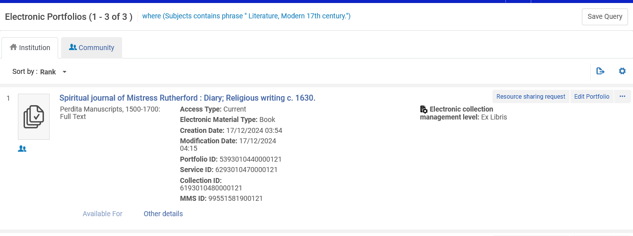
Relinking the portfolio to another bibliographic record
The portfolio can now be retrieved (in Alma and in Discovery) by subject
The portfolio is linked to the Community Zone

Slide 22
xxx@exlibrisgroup.com

